Slide 1
User Scenarios

Slide 2
Scenario 1 – Consult Historical Data
Scenario: Client wants to consult historical data from date X to date Y.
When: Anytime.
Then: Client logs in to the platform, navigates to the historical data page, and applies filtering. The data will be displayed in tabular format.

Slide 3
Scenario 2 – Fetch Historical Data
Scenario: Client wants to retrieve historical data from date X to date Y.
When: Anytime.
Then:
  A. Client logs in to the platform, navigates to the historical data page, applies filtering, specifies the data format (csv, json, xml, text, raw AIS…) and clicks “Download Data”.
  B. Client performs an HTTP GET request to the appropriate endpoint, with authentication, filtering, and format options.

Slide 4
Scenario 3 – Fetch Live Data
Scenario: Client wants to retrieve live data, continuously.
When: Anytime.
Then: Client establishes connection with the server via HTTP, with authentication, filtering, and format options. The server continuously sends data as it is received in the appropriate format, until connection is terminated from the client’s end.

Slide 5
Scenario 4 – Send VDES Message
Scenario: Client want to transmit a message to vessel with MMSI XYZ.
When: Anytime.
Then:
  Client logs in to the platform, navigates to the message sending page, specifies the MMSI of the vessel and the message contents.
  The interface shows an estimate time of message receival at the vessel. Client confirms the scheduled send.
  Subsequent vessel/client messages are kept in a chat-like interface, with successful message receival/sent updates.

Slide 6
Scenario 5 – Visualize Position/Voyage Data
Scenario: Client wants to easily visualize position and voyage data at a certain timestep.
When: Anytime.
Then:
  Client logs in to the platform, navigates to the “global view” page, and selects the desired timestep.
  The page displays an interactable 3D globe displaying the recorded vessel positions and trips on the globe, at the given timestep.
  User may apply filters to control the displayed data.

Slide 7
Scenario 6 – Historical Data Analytics
Scenario: Client wants to analyse historical data statistics.
When: Anytime.
Then:
  Client logs in to the platform, navigates to the historical data page, then to “Dashboard”.
  Client may select from a library of possible charts (to be defined) to build their own custom dashboard. Custom dashboards are saved per-client (to a maximum of 3).
  The dashboard displays analytics relevant to the client.

Slide 8
System Scenarios

Slide 9
Scenario 1 – Download Data
Scenario: A satellite has dumped the gathered maritime data, we must retrieve it from the antennae.
When: Anytime.
Then:
  The system (GSAPI) must periodically fetch (HTTP) the incoming contacts list (every 30 minutes/1 hour);
  At each incoming contact, we establish a TCP connection to the appropriate address, at the provided schedule.
  During the connection we register the totality of the data to be processed (stored in memory/text files).

Slide 10
Scenario 2 – Store Data
Scenario: The system has recently collected data from the antennae.
When: Immediately after data receival.
Then:
  The GSAPI verifies the packet structure and if there’s been corruption.
  If data is valid, GSAPI performs the payload downlink pipeline.*
  We store the result in the database (GSDB), according to the defined schema**, using the database’s secret credentials and its designed port.
* "Y:\Projects\iATON\Technical\Design\Ground Segment\GS - Payloads.docx"
** "Y:\Projects\iATON\Technical\Design\Ground Segment\RelationalSchemaGSDB.png"

Slide 11
Scenario 3 – Retrieving Data
Scenario: The GSAPI must retrieve data to serve to our applications.
When: Anytime.
Then: GSAPI uses ORM (Object Relational Mapping) to automatically build queries and fetch the relevant data.

Slide 12
Scenario 4 – Endpoint Requests
Scenario: An external entity submits a request to one of GSAPI endpoints.
When: Anytime.
Then:
  GSAPI authenticates the sender of the request*. If authentication fails an error response is sent. (END)
  GSAPI verifies user permissions. If the user has no permission to access the endpoint, an error response is sent. (END)
  GSAPI retrieves the data and builds the desired response.
* Using OAuth2 w/ password, JWT Bearer tokens.

Slide 13
Scenario 5 – New User
Scenario: A new user profile must be created to give a new entity access to the system’s features.
When: Anytime.
Then:
  A GSAPI admin fills in user information (contacts, name, description, entity type, etc.)
  A strong password is generated and given to the user. Passwords are hashed before being stored in-DB.
  The new user is persisted in-DB.

Slide 14
User Profiles

Slide 15
Scopes
Our API may define various user scopes.
Scopes control access to API endpoints, website pages, and more.
We may have entire functionalities gated behind the various scopes.
Scopes are cumulative. One user may have zero scopes while another may have them all.

Slide 16
Scopes (Examples)
Those with the scope…
admin may:
  read and write billing data;
  read system monitoring analytics, system documentation;
  read and write user data and permissions;
live may: read live data streams;
historical may: read historic data;
send may: write VDES messages;

Slide 17
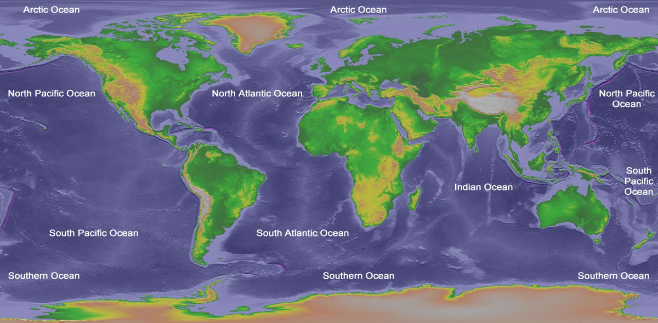
Scopes (Examples, cont.)
We may also define:
Region scopes:
  region:NA: user has access to North Atlantic Ocean data;
  region:SP: South Pacific;
  region:A: Artic;
  etc.
Message Type Scopes:
  message:pos: user has access to position reports;
  message:voyage: user has access to voyage reports;
  etc.

Slide 18
User Profiles (Example)
User A scopes: “live region:NA region:SA message:pos”
  Meaning: This user may access live position data from the North and South Atlantic oceans.
User B scopes: “live historical region:I message:voyage”
  Meaning: This user may access historical and live voyage data from the Indian ocean.
User C scopes: “historical send region:SP message:pos”
  Meaning: This user may access historical positioning data from the South Pacific ocean, as well as send VDES messages to the South Pacific ocean.
These users may be billed differently for different access levels.

